Slide 1
Talk
The talk of each team is 8 min (about 4 - 6 slides) + 3 min questions. Each of the two members of each team has to do half of the talk.
Other than the report, the talk has to include an introduction so that your fellow students get the idea of your project..
The talk has to address the following points:
  topic and motivation
  methods used and what has been done so far
  first results
  next steps (at least two) until the end of the project
The report and presentation are done in workshop style, e.g., you present “the raw plots” of your work in progress and you are not investing too much time in perfect slides.

Slide 2
Time-optimal Flying a VTOL Drone
Leonardo Igler and Larissa Rickler

Slide 3
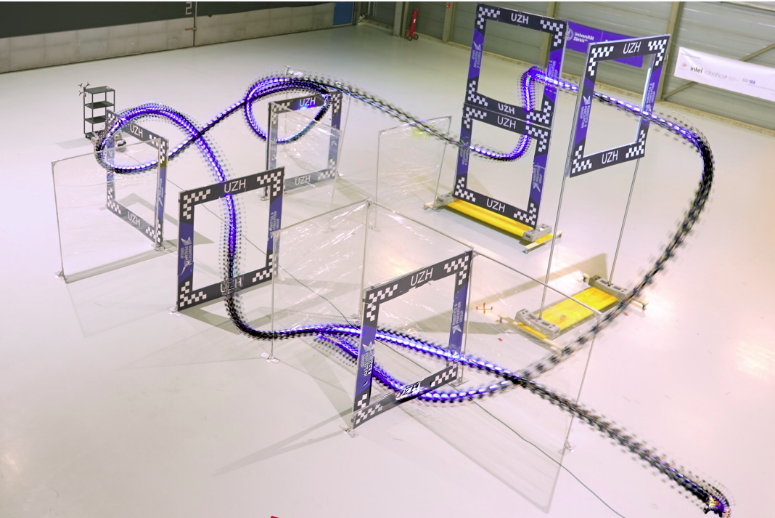
Topic and Motivation
Minimum-time flight for vertical take-off and landing (VTOL) drone
Push platform to its limits
Use Cases:
Rescue
Delivery
Transportation
Fig. 1: Quadrotor races through a race track in the real world.

Slide 4
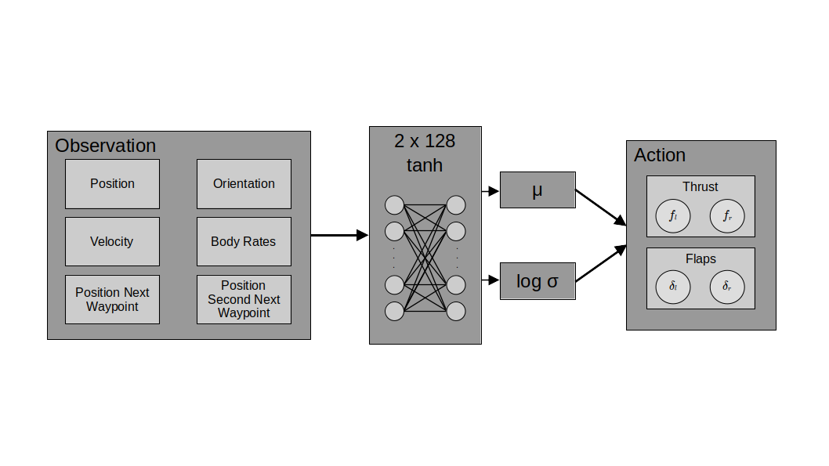
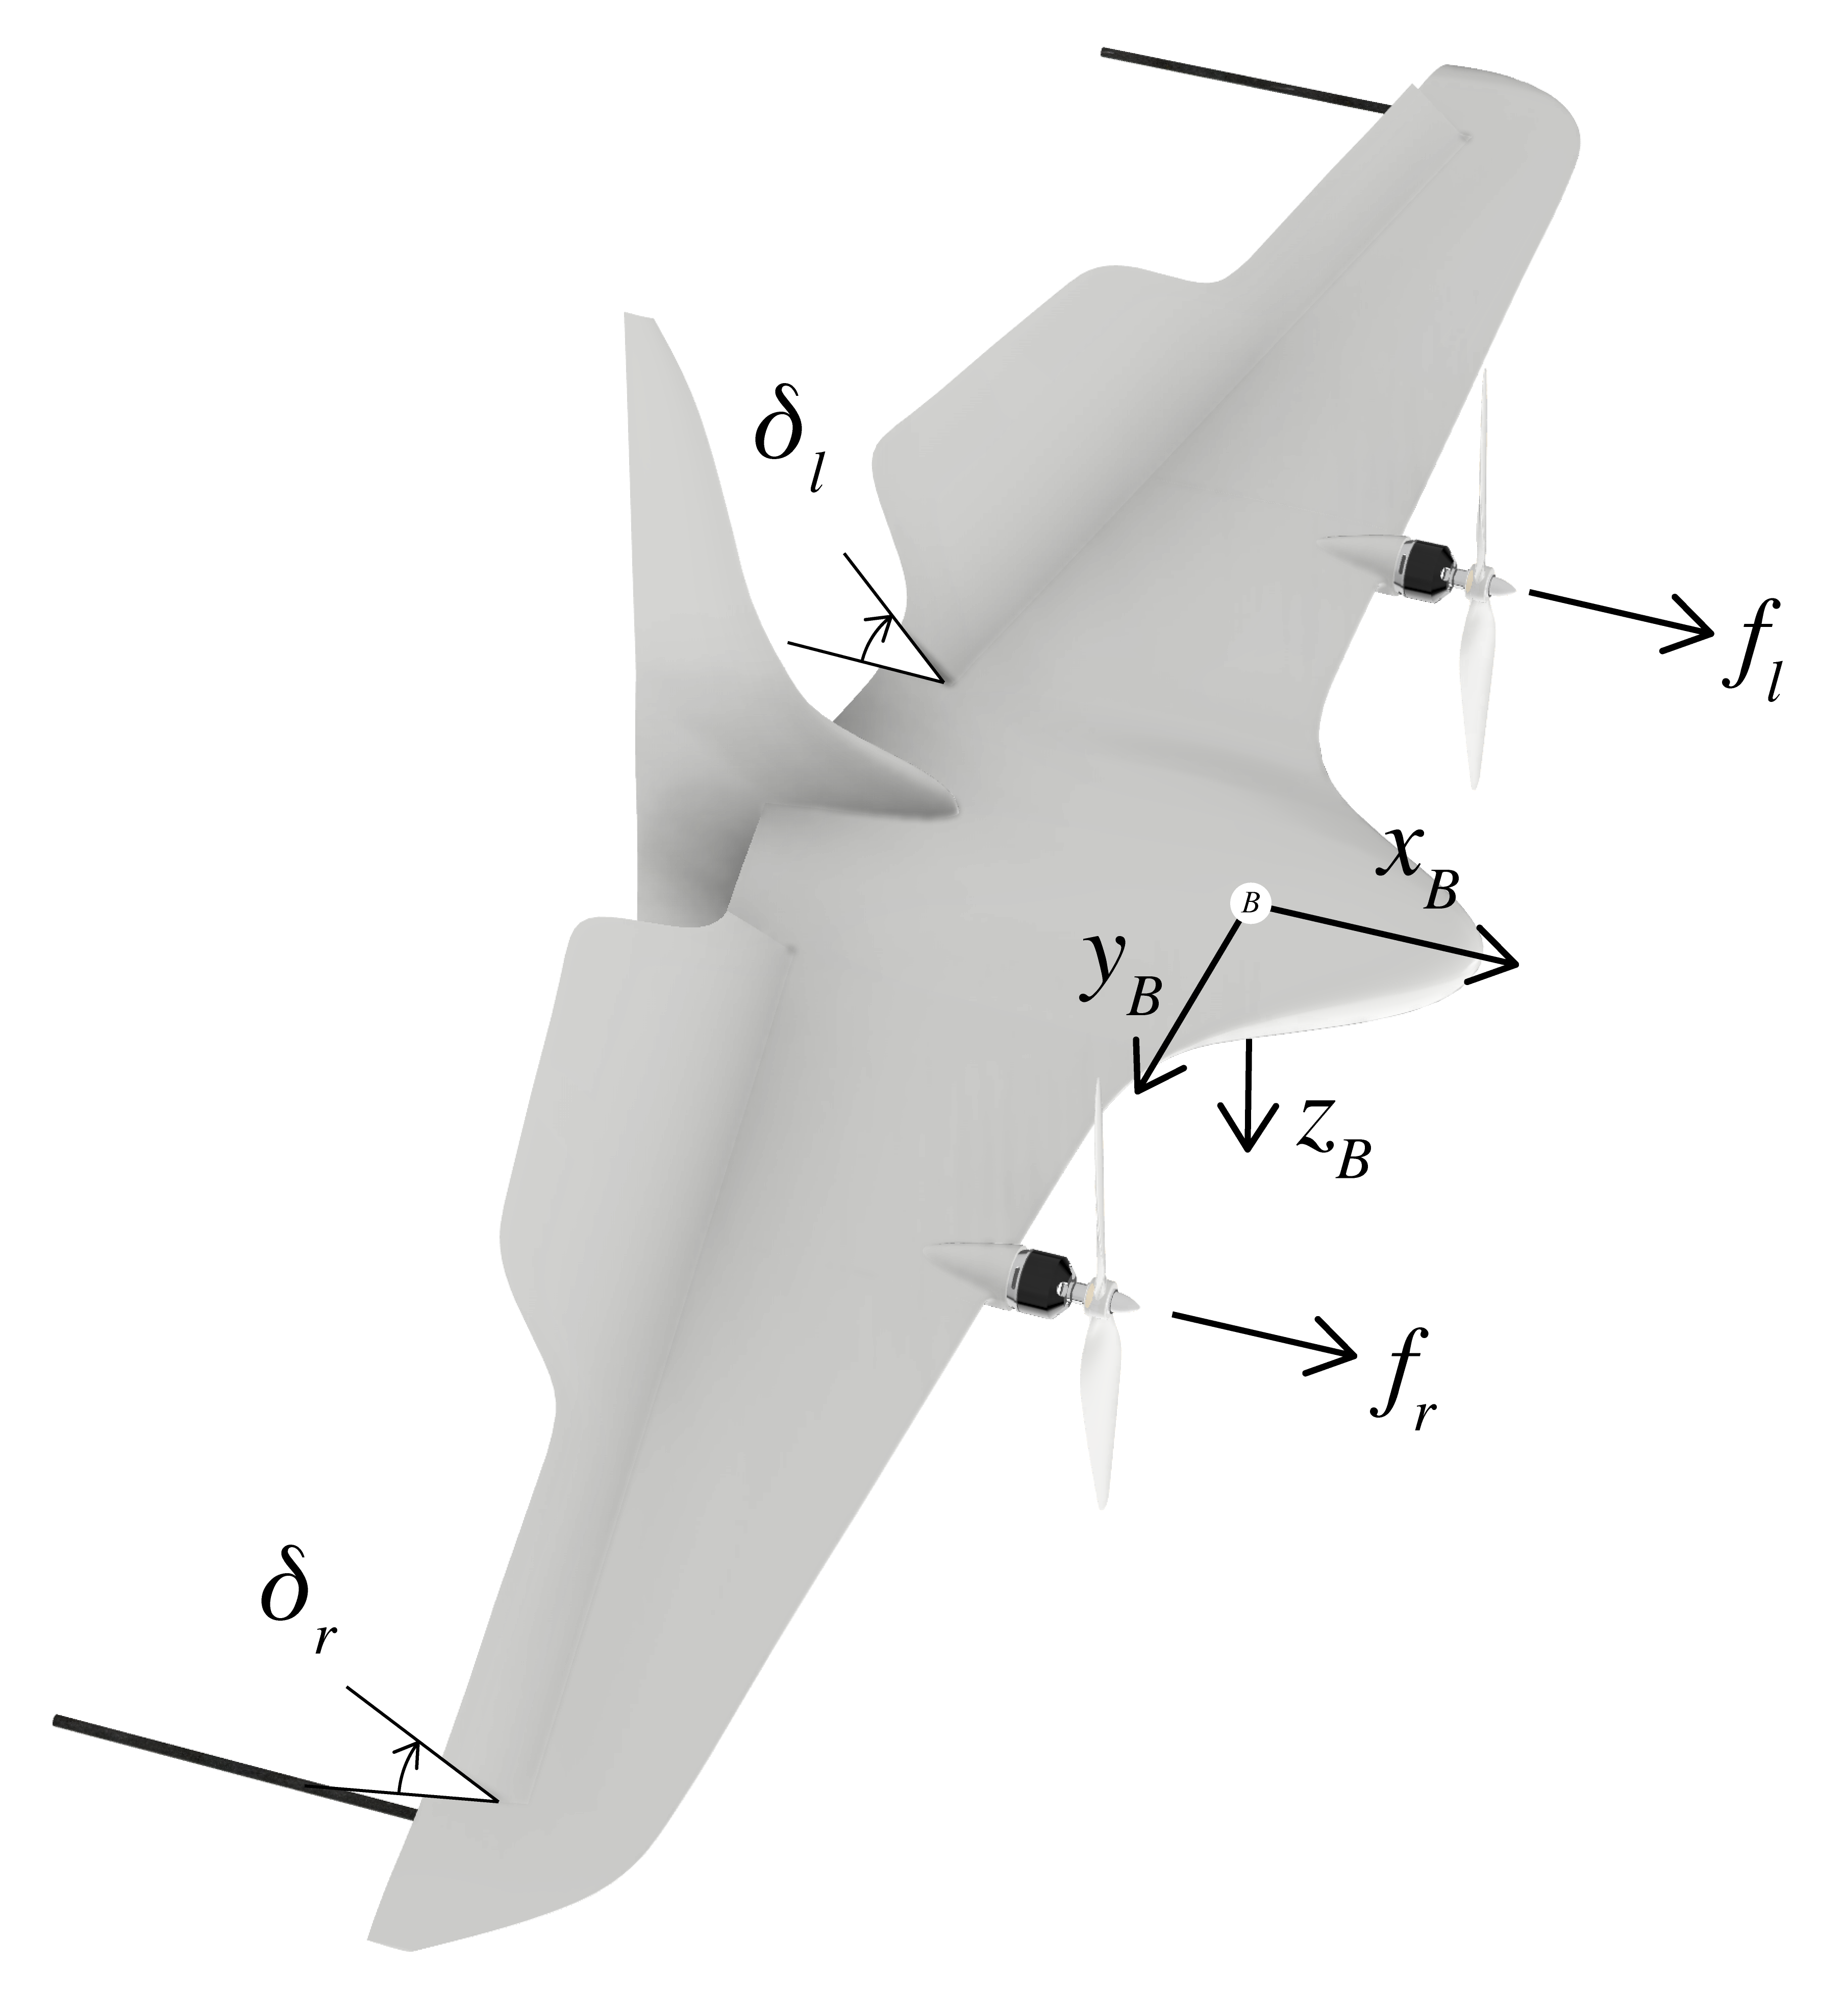
Our Approach in 2D
Actor Critic with PPO
Adam Optimizer

Slide 5
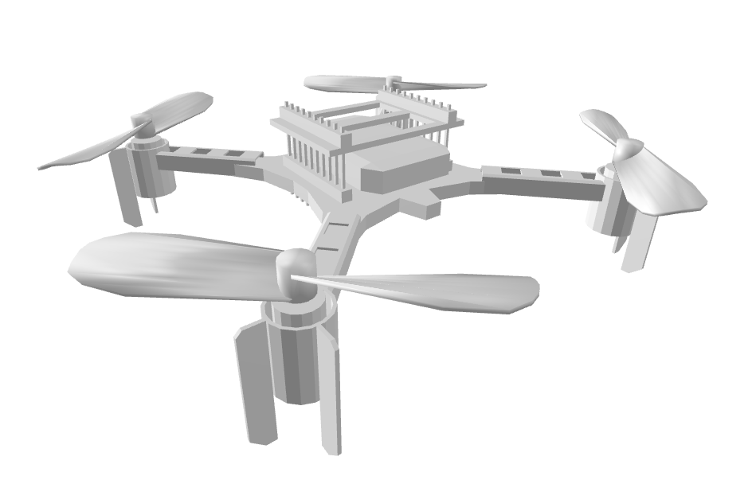
Our Approach in 3D
f2
f1
f4
Actor Critic with PPO
Adam Optimizer
f3
Observation
2 x 256
tanh
Action
Position
Orientation
μ
Thrust
f1
f2
Velocity
Body Rates
.
.
.
.
.
.
log σ
f3
f4
Position Next Waypoint
Position Second Next Waypoint

Slide 6
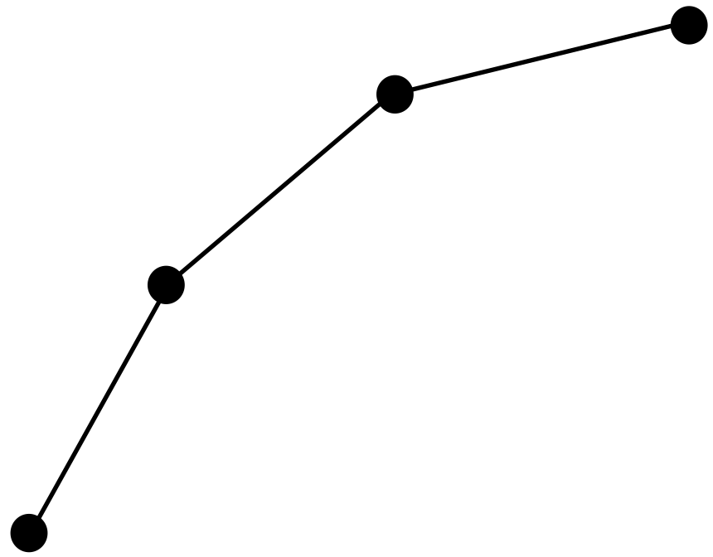
What has been done so far
Problem reduced to 2D
Improved slow and fast learning phases
Adjusted problem back to 3D

Slide 7
Reward Function
Encourage line progression
Encourage reaching points
Penalize spinning
Penalize inactivity

Slide 8
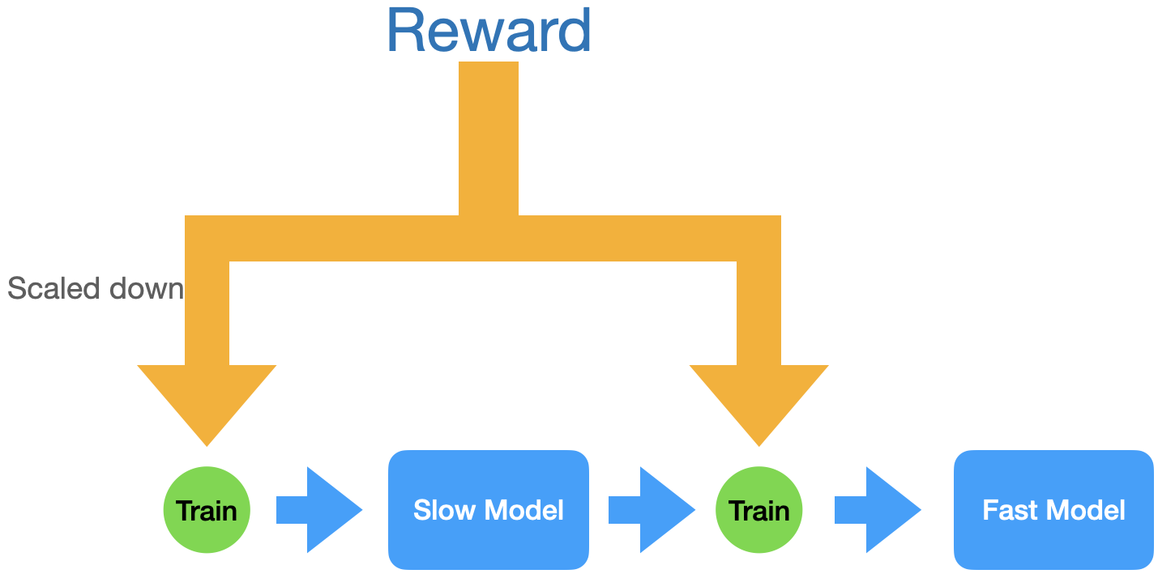
Training Strategy
Two Phases: Slow and Fast
Slow: Learn to follow path
Fast: Time optimality

Slide 9
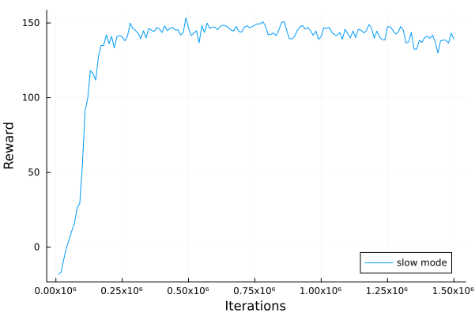
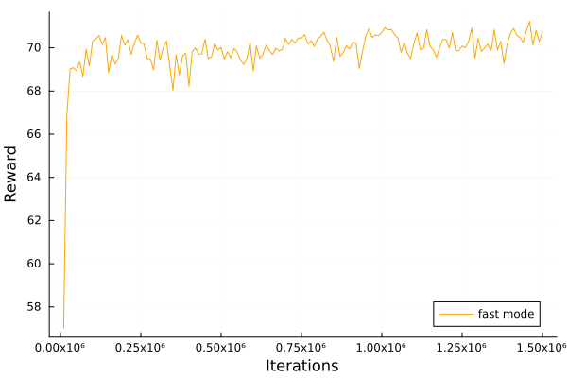
RESULTS 2D

Slide 10
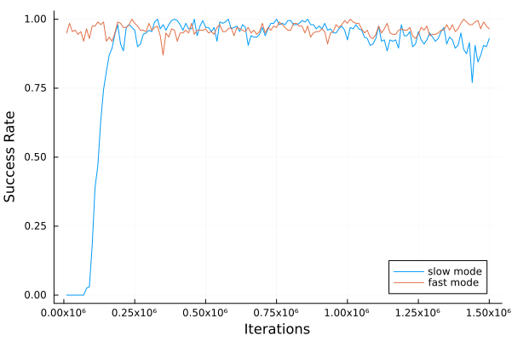
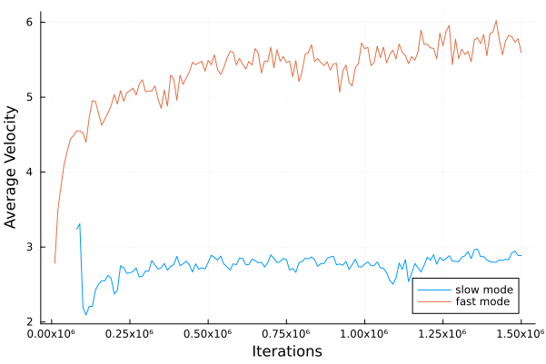
RESULTS 2D

Slide 11
OLD FAST VIDEO 2D
https://youtu.be/IRfzMXrSIUQ

Slide 12
NEW FAST VIDEO 2D
https://youtu.be/IRfzMXrSIUQ

Slide 13
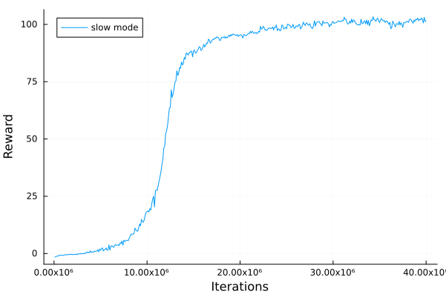
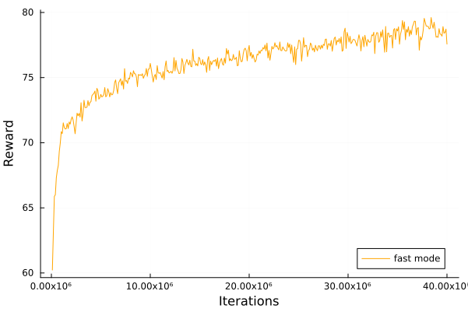
RESULTS 3D

Slide 14
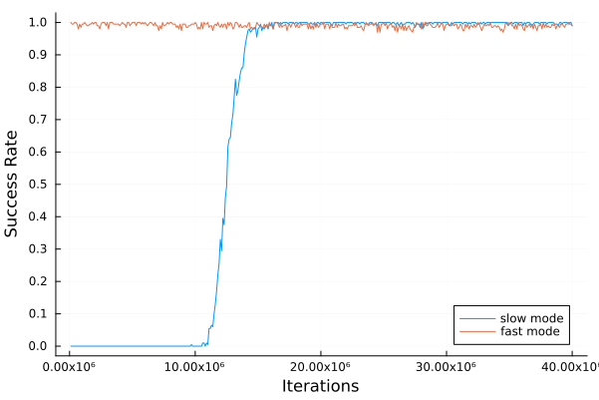
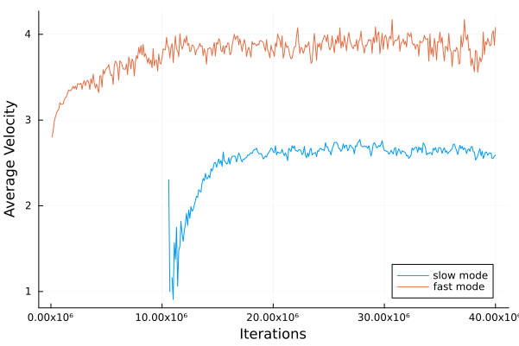
Results 3D

Slide 15
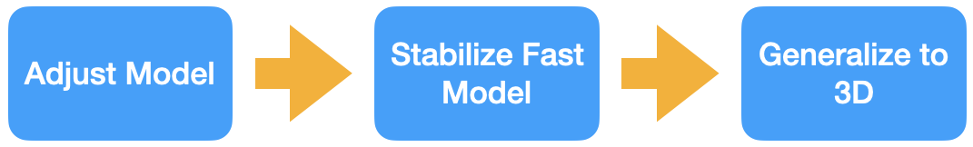
Next Steps

Slide 17
Appendix

Slide 18
Observation
Position
1 x 128
Velocity
2 x 128
tanh
.
.
.
μ
Action
Position next waypoint
Thrust
.
.
.
.
.
.
fl
fr
Orientation
1 x 128
log σ
Body Rates
.
.
.
Position second next waypoint
Actor: VTOL 2D

Slide 19
Observation
Position
Velocity
2 x 128
tanh
1 x 128
Position next waypoint
μ
.
.
.
Value
Orientation
.
.
.
.
.
.
Body Rates
Position second next waypoint
Critic: VTOL 2D

Slide 20
Observation
Position
1 x 256
Velocity
2 x 256
tanh
.
.
.
Action
μ
Thrust
Position next waypoint
f1
f2
.
.
.
.
.
.
Orientation
1 x 256
f3
f4
log σ
Body Rates
.
.
.
Position second next waypoint
Actor: quadcopter 3D

Slide 21
Observation
Position
Velocity
2 x 256
tanh
1 x 256
Position next waypoint
μ
.
.
.
Value
Orientation
.
.
.
.
.
.
Body Rates
Position second next waypoint
Critic: quadcopter 3D

Slide 22
Reward Function
Encourage line progression in each step

Slide 23
Reward Function
Encourage line progression
  Counteracts to possible singularities in Δprogress

Slide 24
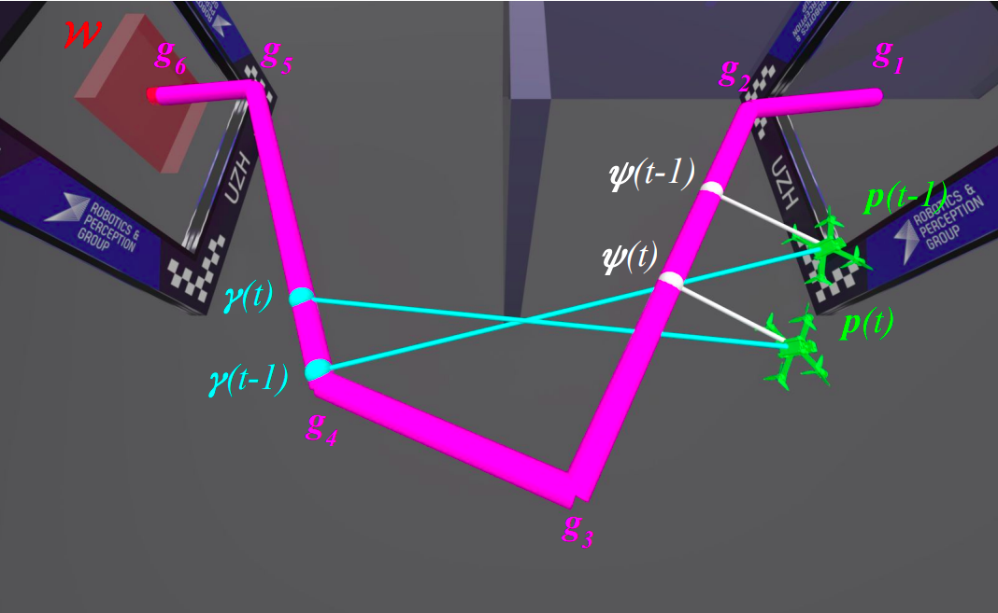
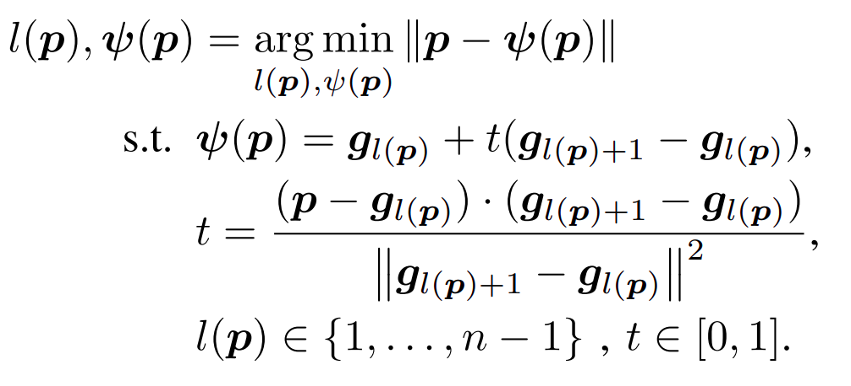
Reward Function
Progress calculation
Fig. 2: Illustration of guiding path between waypoints g. Nearest point on the guiding path ψ from drone position p is used to calculate progress reward rp(t) and rs(t) while the next and second next waypoints are used as a part of observation.

Slide 25
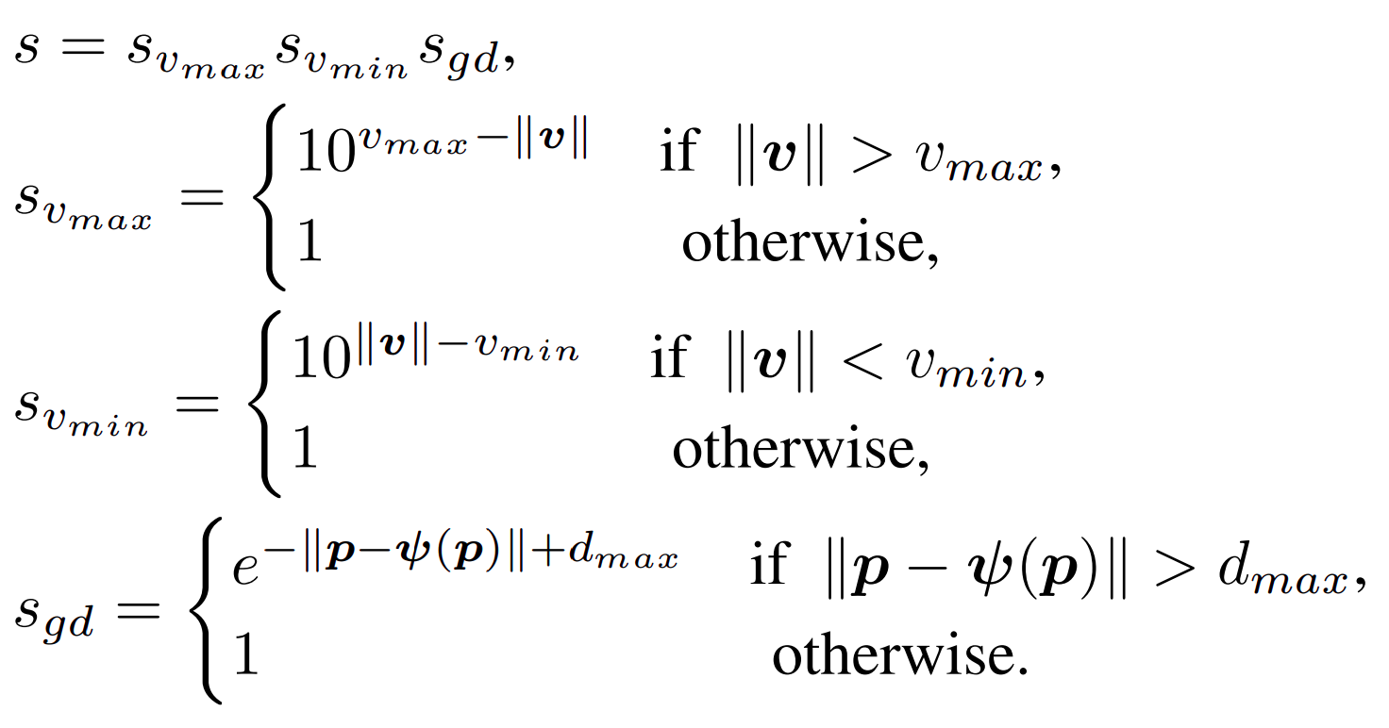
Reward Function
Scale down reward of progress.
Encourages velocity in certain range.

Slide 26
Reward Function
Encourage reaching points
  Only added if waypoint is passed within distance < disttol

Slide 27
Reward Function
Penalize spinning

Slide 28
Reward Function
Penalize inactivity
  Only subtracted if hight falls under 0
fall = 1

Slide 29
Termination Criteria
Body rates to high
Velocity to high
Drone falls below -1.0 (SAC -0.1)
Too much time passed
Too far off path
All waypoints reached

Slide 30
Image Sources
From https://arxiv.org/pdf/2203.15052v1.pdf
Fig. 1: Our quadrotor races through a complex race track inthe real world.
Fig. 2: Illustration of guiding path between waypoints g. Nearest point on the guiding path ψ from drone position p is used to calculate progress reward rp(t) and rs(t) while the next and second next waypoints are used as a part of observation.
https://arxiv.org/pdf/2203.15052v1.pdf

Slide 31
What has been done so far
2D
  Flight to one fix point
  Flight to random point
  Slow flight on random trajectory
  Fast flight on random trajectory

Slide 32
Next Steps
Adjust network architecture
Stabilize fast flight in 2D
Generalize achievements to 3D
  Adjust observation and action space
  Adjust network architecture for 3D
  (Optional: change drone model to quadrotor)

